Slide 1





TRIGGERING MECHANISM FOR SHM & THE ISSUE – SENSING SCHEME
Always-on
Duty-cycle
Event-triggered
active
inactive
events of interest
partially miss out
inactive miss out
low power miss out

Slide 2
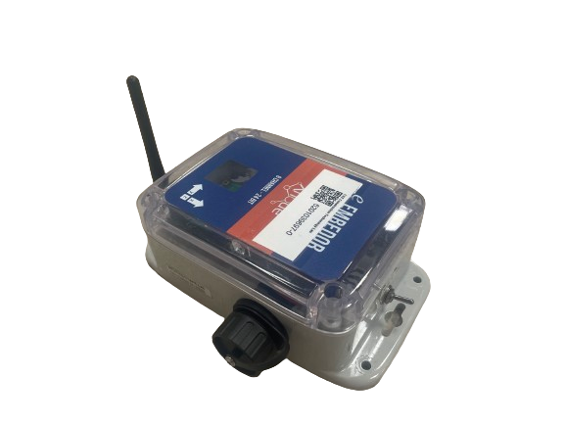
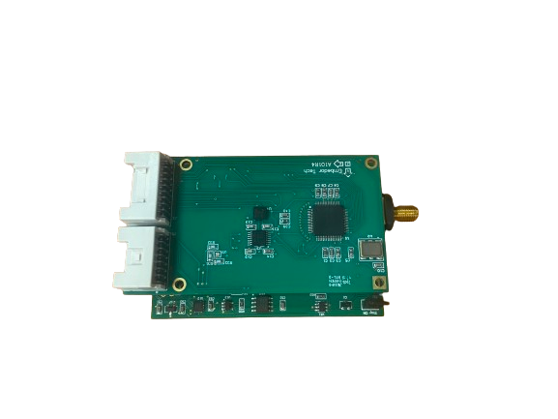
TRIGGERING MECHANISM FOR SHM & THE ISSUE – SENSING SCHEME
low power mode：
DIGITAL ACCELEROMETER: ADXL362
- resolution: 12-bit
- power consumption: 1.8uA (sensing, 100Hz) ; 270nA (sleep)
high resolution mode：
LIS344
ANALOG ACCELEROMETER - LIS344
ADC – ADS131E08
wakeup
- resolution: 24-bit
- power consumption: ~ 5mW (sensing); 3uA(sleeping)
ADXL362

Slide 3
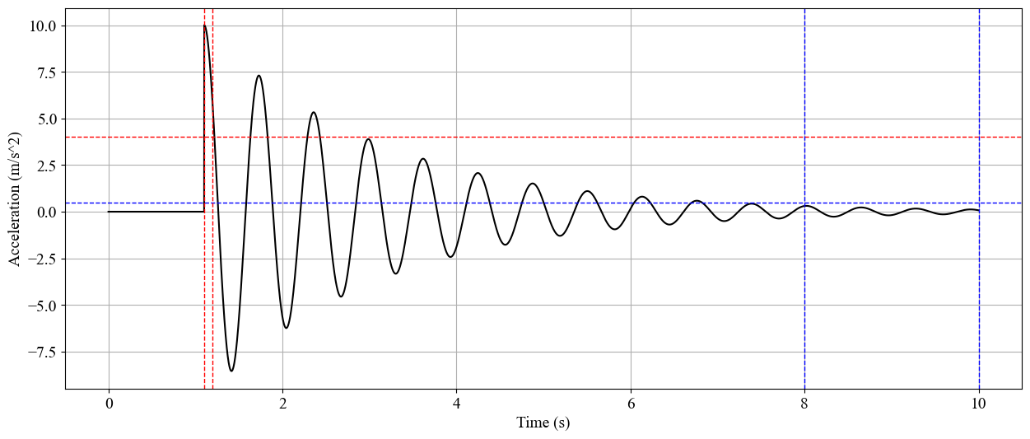
TRIGGERING MECHANISM FOR SHM & THE ISSUE – TRIGGER SENSING
Activation
Duration
Activation
Threshold
Deactivation
Threshold
Deactivation
Duration
can be viewed as a two-class classifier： events of interest / no interest

Slide 4
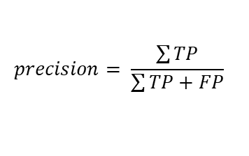
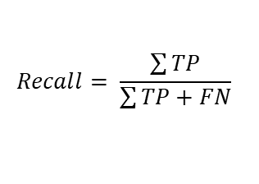
TRIGGERING MECHANISM FOR SHM & THE ISSUE – TYPE I & II ERROR
Triggering Sensing Objectives:
reduce missed out events of interests. - ⬆️ Recall
reduce false alarms. - ⬆️ Precision
Ground Truth
positive
negative
True Positive (TP)
False Positive (FP)
[TYPE I]
$$precision= \frac{\sum{TP}}{\sum{TP+FP}}$$
positive
Prediction
False Negative (FN)
[TYPE II]
True Negative (TN)
negative
interested
Negatively Related
not interested
$$Recall= \frac{\sum{TP}}{\sum{TP+FN}}$$

Slide 5
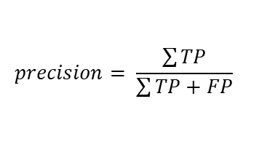
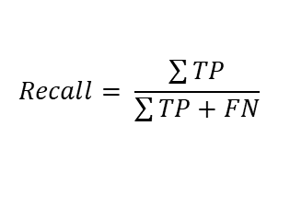
TRIGGERING MECHANISM FOR SHM & THE ISSUE – CHALLENGES
Ground Truth
CHALLENGES
positive
negative
True Positive
(TP)
False Positive
(FP)
Imbalanced Data & Unknown Distribution
$$precision= \frac{\sum{TP}}{\sum{TP+FP}}$$
No Ground Truth
positive
Prediction
Partial Observability
False Negative
(FN)
True Negative
(TN)
Long Time & Costful Feedback
negative
$$Recall= \frac{\sum{TP}}{\sum{TP+FN}}$$

Slide 6
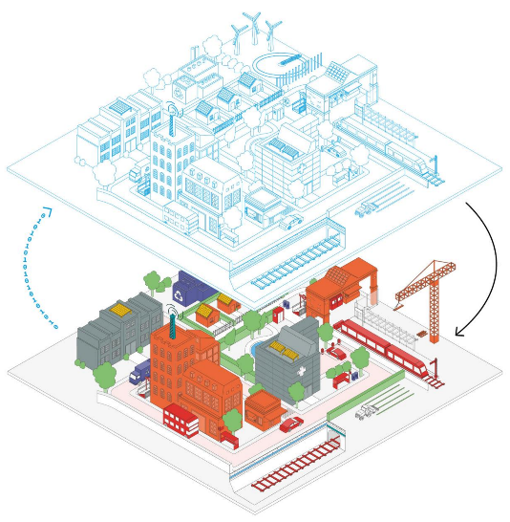

SOLUTION: FEEDBACK LOOP CONTROL SYSTEM + DIGITAL TWIN
monitoring
diagnosis
simulation
predictions
optimization
control
...
DIGITAL SPACE
ENVIRONMENT
SYSTEM/PROCESS
CONTROLLER
data
information
shape
vibration
temp.
humidity
…
ESTIMATOR
PHYSICAL SPACE
FEEDBACK LOOP CONTROL
DIGITAL TWIN

Slide 7





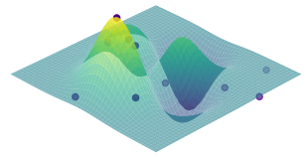
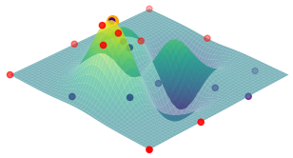

Excitation Simulated/Transferred
Digital Model
duration
Response Signal
threshold
Excitation in Digital Space
Excitation in Physical Space
Physical Structure
duration
Response Signal
threshold
ENVIRONMENT
– EXCITATION & STRUCTURE
SYSTEM
– TRIGGERING MECHANISM
reference
$$F_{β}$$
$$F_{β}$$
duration
threshold
threshold
duration
threshold
duration
PHASE I
PHASE II
CONTROLLER
– BAYESIAN OPTIMIZATION
– SURROGATE MODEL - GPR
PREPROCESS
captured signal
$$F_{β}$$
TP
EVENT TYPE
event type
$$F_{β}$$
P
TP + FP
PREPROCESS
captured signal
$$\left(1+β^{2}\right)\frac{P∙R}{β^{2}∙P+R}$$
PRECISION
CNN
Threshold/Duration
threshold
duration
R
R
Recall (TP/(TP+FN))
TP & FN
Threshold/Duration
threshold
duration
RECALL
EVALUATOR
– F-BETA CALCULATION
DNN
LEGEND
Real Data
Training Data
Physical Space
Digital Space
NN Training
Estimation

Slide 13

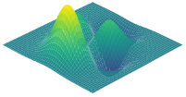
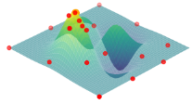





SOLUTION: FEEDBACK LOOP CONTROL SYSTEM
ENVIRONMENT – EXCITATION & STRUCTURE
SYSTEM – TRIGGERING MECHANISM
response signal
duration
threshold
EXCITATION
PHYSICAL STRUCTURE
reference
CONTROLLER – BAYESIAN OPTIMIZATION
$$F_{β}$$
$$F_{β}$$
threshold
duration
threshold
duration
threshold
duration
EVALUATOR – F-BETA CALCULATION
SURROGATE MODEL
- GPR
BAYESIAN OPTIMIZATION
TP
$$F_{β}$$
TP + FP
PRECISION
PREPROCESS
$$\left(1+β^{2}\right)\frac{P∙R}{β^{2}∙P+R}$$
TP
$$F_{β}$$
TP + FN
RECALL
CNN

Slide 14



SOLUTION: FEEDBACK LOOP CONTROL SYSTEM + DIGITAL TWIN
ENVIRONMENT – EXCITATION & STRUCTURE
SYSTEM – TRIGGERING MECHANISM
duration
response signal
threshold
EXCITATION
PHYSICAL STRUCTURE & DIGITAL TWIN
reference
CONTROLLER – BAYESIAN OPTIMIZATION
$$F_{β}$$
$$F_{β}$$
duration
threshold
threshold
duration
threshold
duration
EVALUATOR – F-BETA CALCULATION
SURROGATE MODEL
- GPR
BAYESIAN OPTIMIZATION
TP
$$F_{β}$$
PREPROCESS
captured signal
P
TP + FP
$$\left(1+β^{2}\right)\frac{P∙R}{β^{2}∙P+R}$$
PRECISION
CNN
threshold
$$F_{β}$$
R
R
duration
RECALL
DNN

